Slide 1
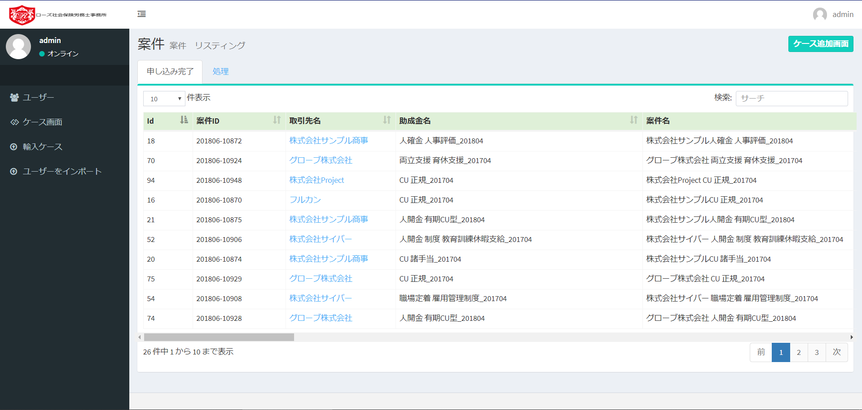
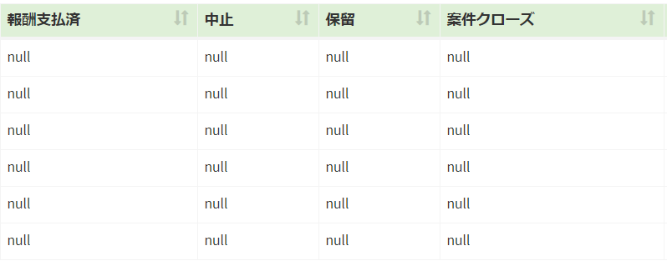
Admin > ケース画面
Characters are still distorted.
It seems difficult to modify, so only LOGO OK.
Correct the wording進行中
Correct the wording
クローズ
Correct the wording案件をインポート
null means blank.
Not to print “null”

